Slide 1


202244012
-
Project
-
sungminNoh
NO CAP
week 4

Slide 2
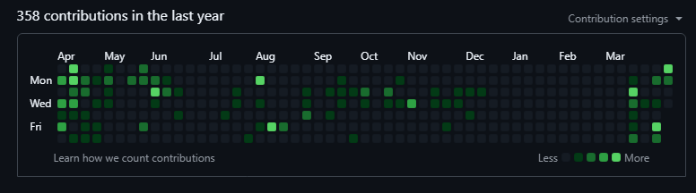
Nothing to write
🌱
-
Meaningless Text

Slide 3
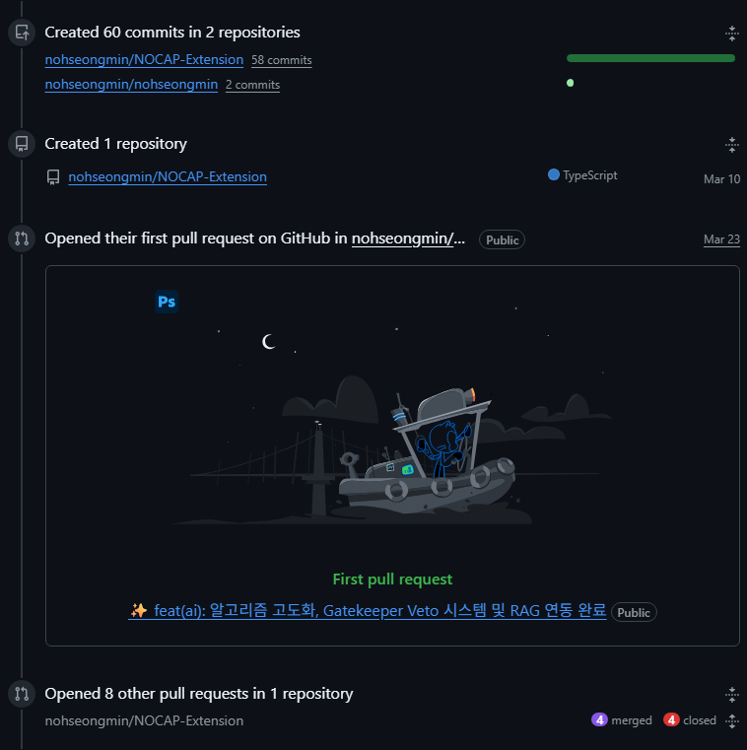
Nothing to write
🌱
-
Meaningless Text

Slide 4
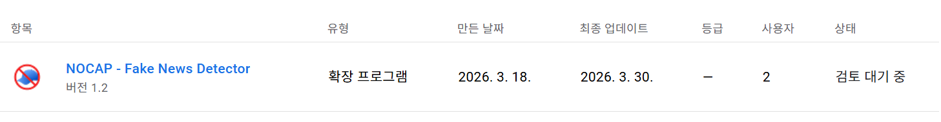
Nothing to write
Progress
-
Meaningless Text

Slide 5
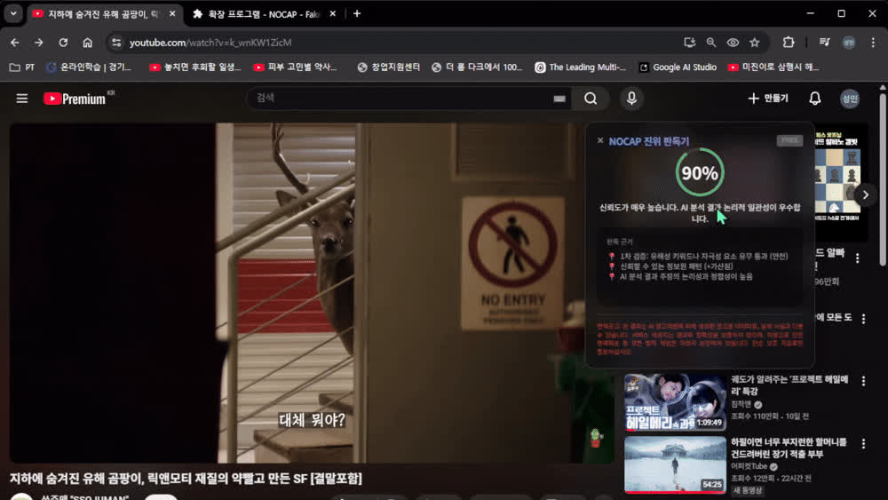
Changes
Nothing to write
-
Meaningless Text

Slide 6
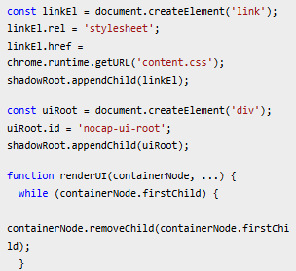
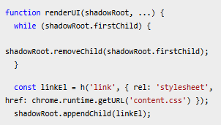
Changes
Nothing to write
-
Meaningless Text

Slide 7


Changes
Nothing to write
-
Meaningless Text

Slide 8

Changes
Nothing to write
-
Meaningless Text

Slide 9
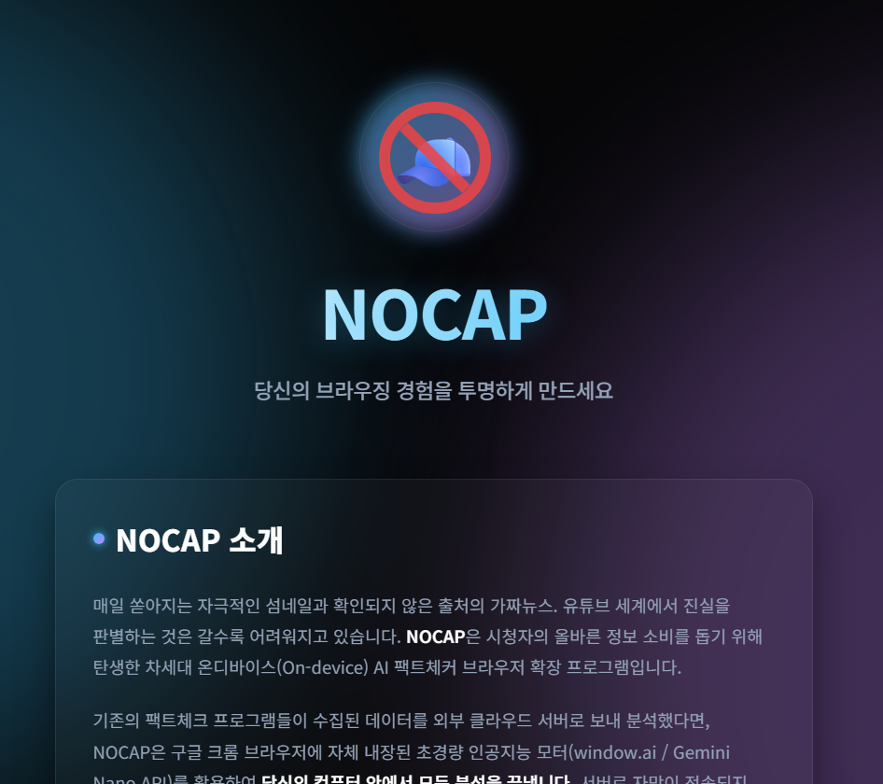
Changes
Nothing to write
-
Meaningless Text

Slide 10
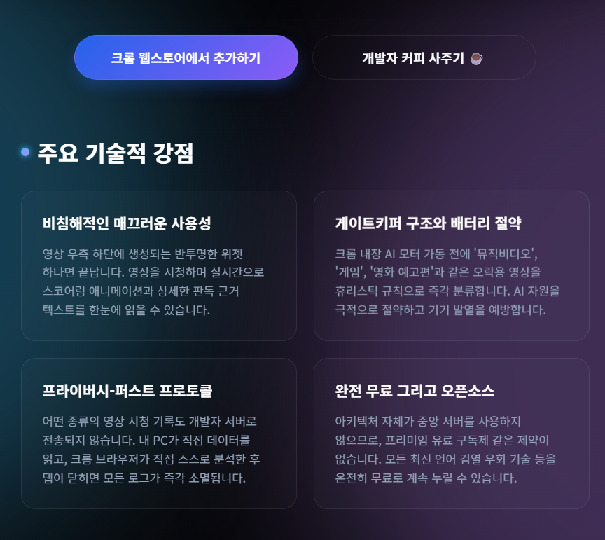
Changes
Nothing to write
-
Meaningless Text

Slide 11
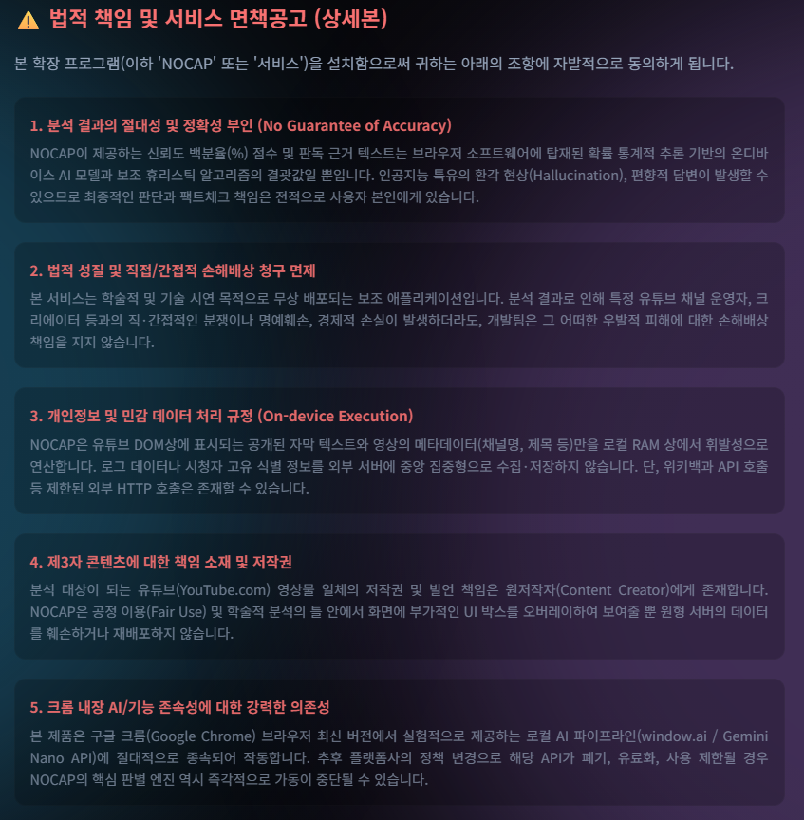
Changes
Nothing to write
-
Meaningless Text

Slide 12


Changes
Nothing to write
-
Meaningless Text

Slide 13
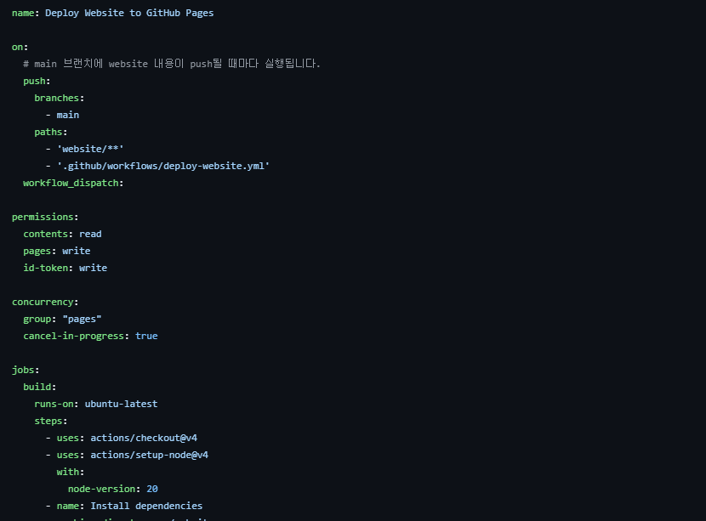
Changes
Nothing to write
-
Meaningless Text

Slide 14
202244012
-
Project
-
sungminNoh
QnA
stop

